Slide 1
Four ways that NoSQL systems handle big data problems
https://livebook.manning.com/book/making-sense-of-nosql/chapter-6/120

Slide 2
Analytics – Computation Ways
Centralized Model
Decentralized Model
Multiparty computation
Centralized Agent based
Distributed and Parallel
Don’t Move the data, Move the Computation

Slide 3
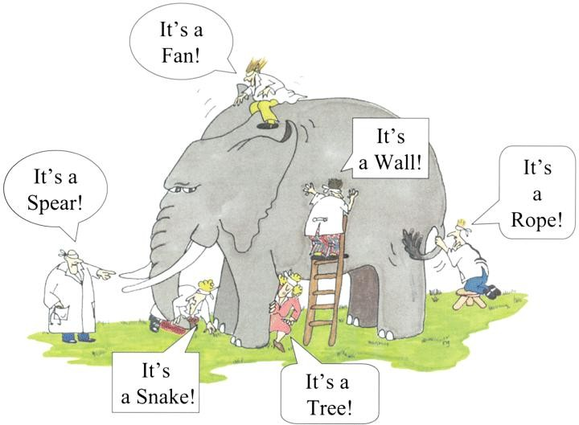
The Blind men and the Elephant

Slide 4
1. Moving queries to the data, not data to the queries
Don’t move the data, move the computation.

Slide 5
2. Using hash rings to evenly distribute data on a cluster
Consistent way of assigning a document to a processing node.
Using a hash ring technique to evenly distribute big data loads over many servers with a randomly generated 40-character key is a good way to evenly distribute a network load.
Hash rings are common in big data solutions because they consistently determine how to assign a piece of data to a specific processor.
Hash rings take the leading bits of a document’s hash value and use this to determine which node the document should be assigned.
This allows any node in a cluster to know what node the data lives on and how to adapt to new assignment methods as your data grows.
Partitioning keys into ranges and assigning different key ranges to specific nodes is known as keyspace management.
Most NoSQL systems, including MapReduce, use keyspace concepts to manage distributed computing problems.

Slide 6
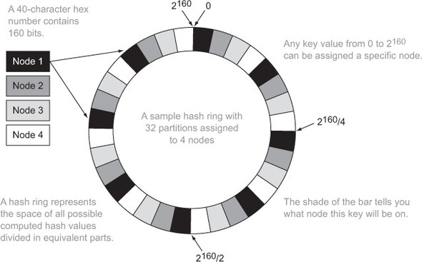
Using a hash ring to assign a node to a key that uses a 40-character hex number. This number can be expressed in 2¹⁶⁰ bits. The first bits in the hash can be used to map a document directly to a node. This allows documents to be randomly assigned to nodes and new assignment rules to be updated as you add nodes to your cluster.

Slide 7
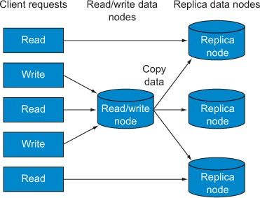
3. Using replication to scale reads

Slide 8
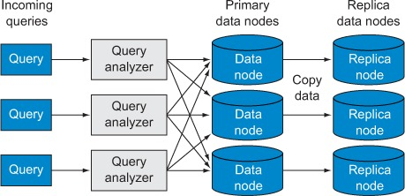
4. Letting the database distribute queries evenly to data nodes

